Slide 1
Data Federation Strategies for ATLAS using XRootD
Ilija Vukotic
On behalf of the ATLAS Collaboration
Computation and Enrico Fermi Institutes
University of Chicago
Computing in High Energy and Nuclear Physics (CHEP 2013)
Amsterdam, The Netherlands
October 2013

Slide 2
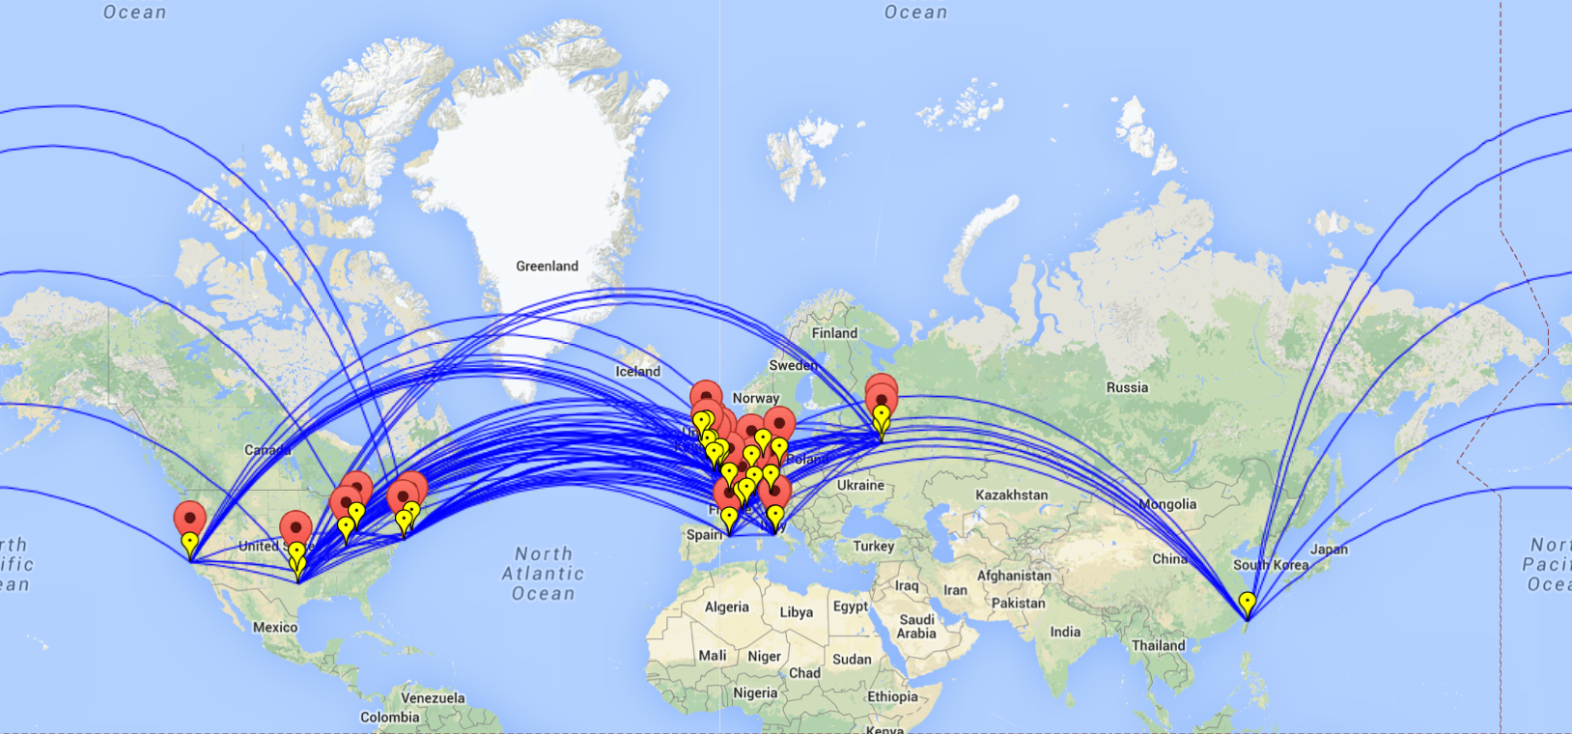
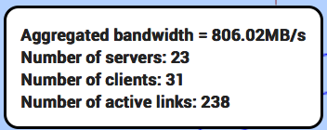
What is FAX?
FAX (Federated ATLAS Xrootd) is a way to unify direct access to a diversity of storage services used by ATLAS
Read only access
Global namespace
Currently 42 federated sites
Regions covered: US, DE, UK, ES, and CERN

Slide 3
But Not only that!
Initial use cases
Failover from stage-in problems with local storage
Gain access to more CPUs using WAN direct read access
Allow brokering to Tier 2s with partial datasets
Opportunistic resources without local ATLAS storage
Use as caching mechanism at sites to reduce local data management tasks
Eliminate cataloging, consistency checking, deletion services
WAN data access group formed in ATLAS to determine use cases & requirements on infrastructure

Slide 4
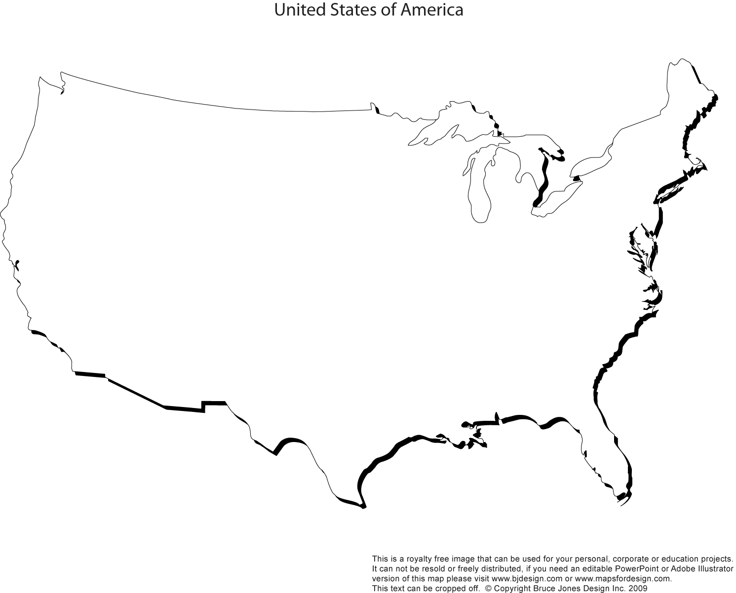


HOW it works
redirector
endpoint
bnl
ATLAS-XRD-ASIA
GLRD
ATLAS-XRD-EU
Data can be asked for from any endpoint and redirector
Data are transferred directly from server to user
Searching for the file is fast, delivering is more important
Ideally one should use the one with best connection
Usually that’s the closest one
XRD-CENTRAL
NET2
MWT2
AGLT2
SLAC
BNL
OCHEP
SWT2

Slide 5
What are the ingredients?
gLFN – global Logical Filename
Protocol
Storage systems at sites
Redirectors
Federation description
Monitoring
Storage service integration
Applications
Documentation
Simplicity for user requires a smart (therefore complex) system.

Slide 6
Global Logical Filenames
In ATLAS data management based on DQ2
Files are organized in DataSets, DataSets in DataContainers, exist in one or more SpaceTokens at one or more StorageElements and are registered in DQ2
File catalog database LFC is an Oracle DB and contains mapping of logical file names to their physical path(s)
Each endpoint when asked for a file, queries LFC to find exact path of the file before delivering it or responding that file is not there
Proved to be large complication: multiple LFCs, authentication issues, scaling, latencies
Now moving to new DDM system - RUCIO
Simple function will derive PFN from gLFN
Much faster, more reliable, easier to set up.

Slide 7






Access Protocol: XRootD
The XROOTD project aims at giving high performance, scalable, fault tolerant access to data repositories of many kinds
Widely used in High Energy Physics
Supported by ROOT
XRootD clients: xrdcp and xrdfs
File path start with root://servername:[port]/…
Can serve from any posix storage, dCache xrootd plugin implements protocol

Slide 8
A Diversity of Storage Systems
ATLAS uses 80+ WLCG computing sites organized in Tiers
Various storage technologies are used: dCache, DPM, Lustre, GPFS, Storm, XRootD and EOS
Single source of deployment documentation:https://twiki.cern.ch/twiki/bin/view/AtlasComputing/JoiningTheATLASFederation
To ease support we have experts for different technologies
To ease communications we have contact persons per national cloud

Slide 9
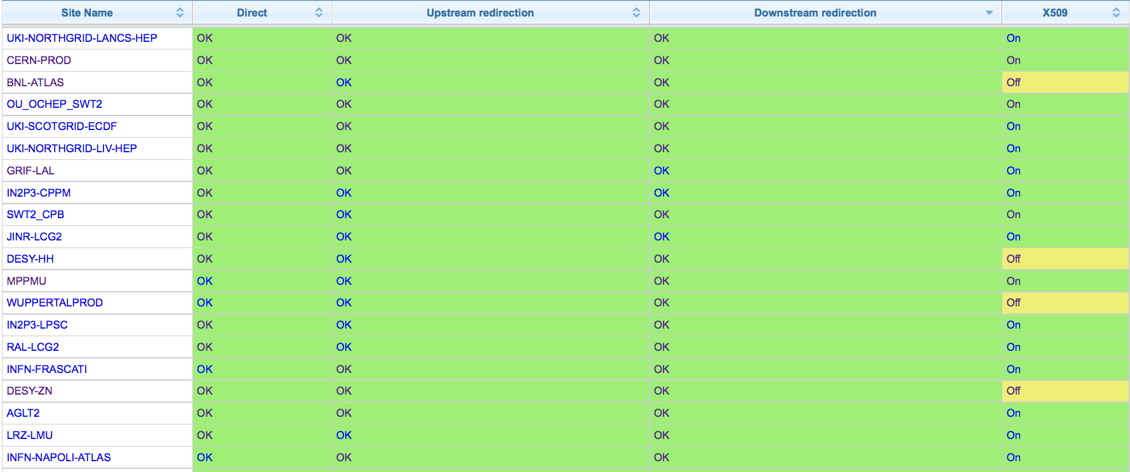
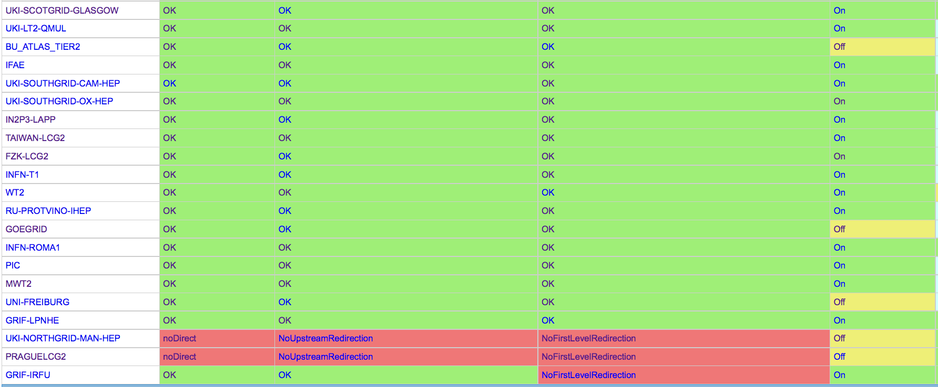
Storage Endpoints
Continuous Status Monitoring
Coverage
T0 | T1 | T2D
1/1 | 6/12 | 34/44
41 sites
72% done
All of USA, UK, DE, IT, RU, ES
Most of FR
Recently joined: Taiwan, PIC, IFAE
Next: AU, CA, NL

Slide 10
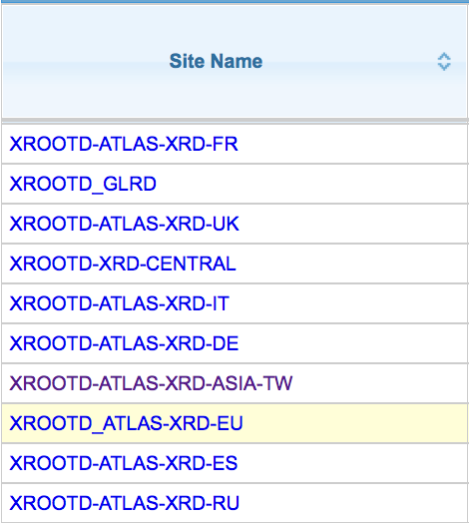
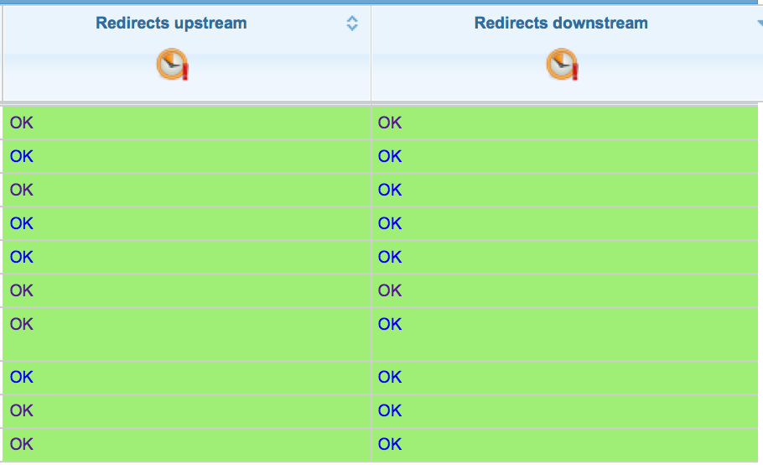
Redirector Network
Lightweight and easily managed
GLRD
EU
ASIA
US central
UK
FR
DE
RU
ES
IT

Slide 11
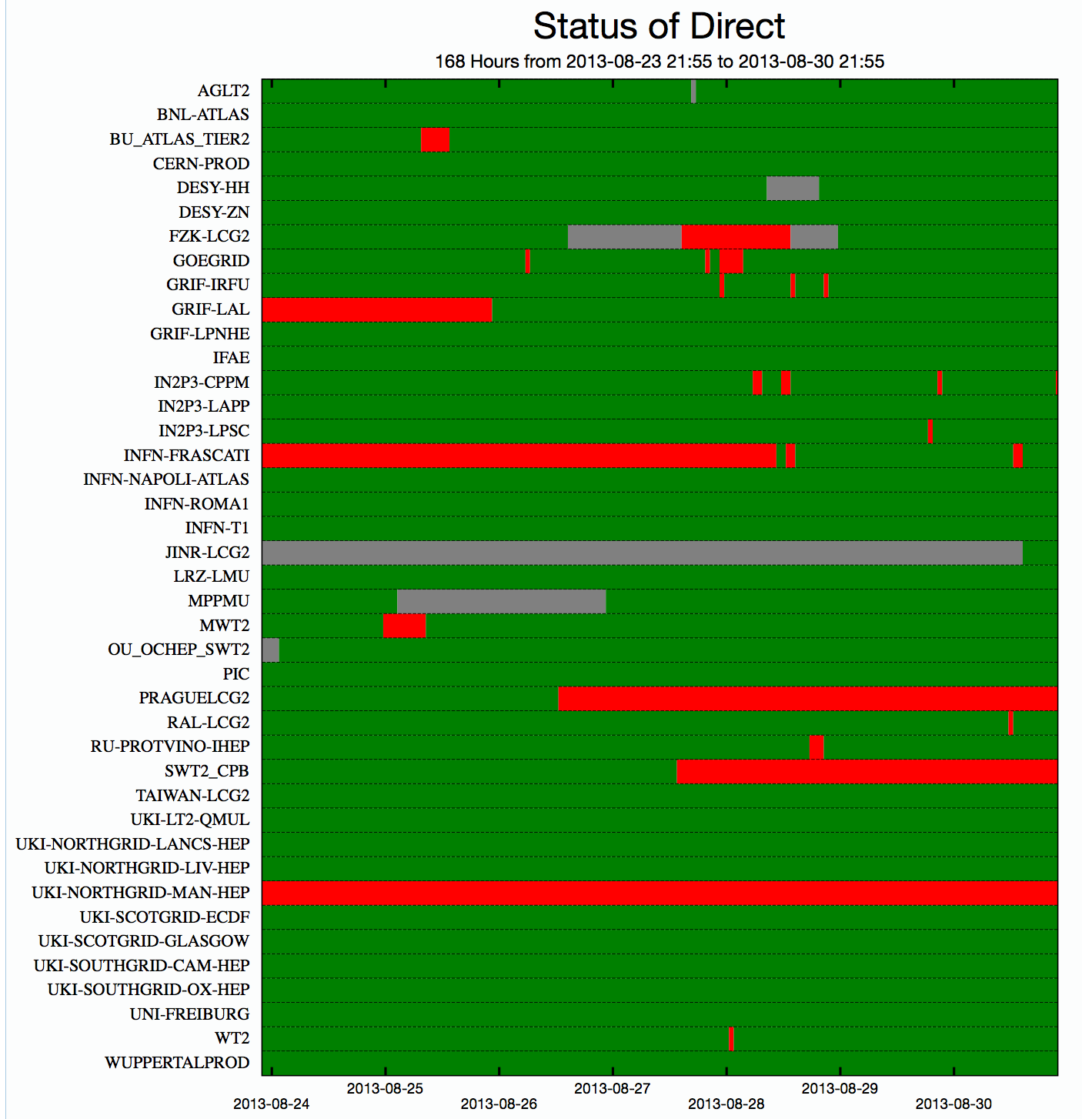
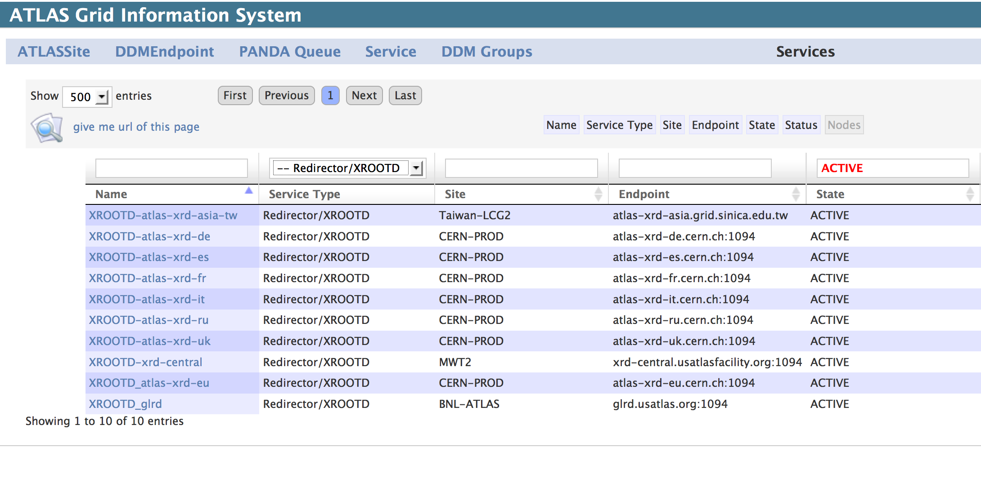
Describing the federation
Both individual users and production/testing systems need to know access points, redirectors and their current status
FAX topology recorded in the ATLAS Grid Info System
Current status (and its history) are kept in Site Status Board (SSB)
Missing test dataset
Missing test dataset
Missing test dataset
Missing test dataset
Missing test dataset

Slide 12
Monitoring the infrastructure
xRootD
dCache
DPM
posix
xRootD
Castor
dCache
xRootD
xroot4j
xRootD
xroot4j¹
Monitor
Monitor
UDP
Collector at CERN
Collector at SLAC
ActiveMQ
Consumers:
Popularity DB
SSB
Dashboard
Detailed stream
Summary
stream
MonaLisa
¹ dCache XRootD door

Slide 13
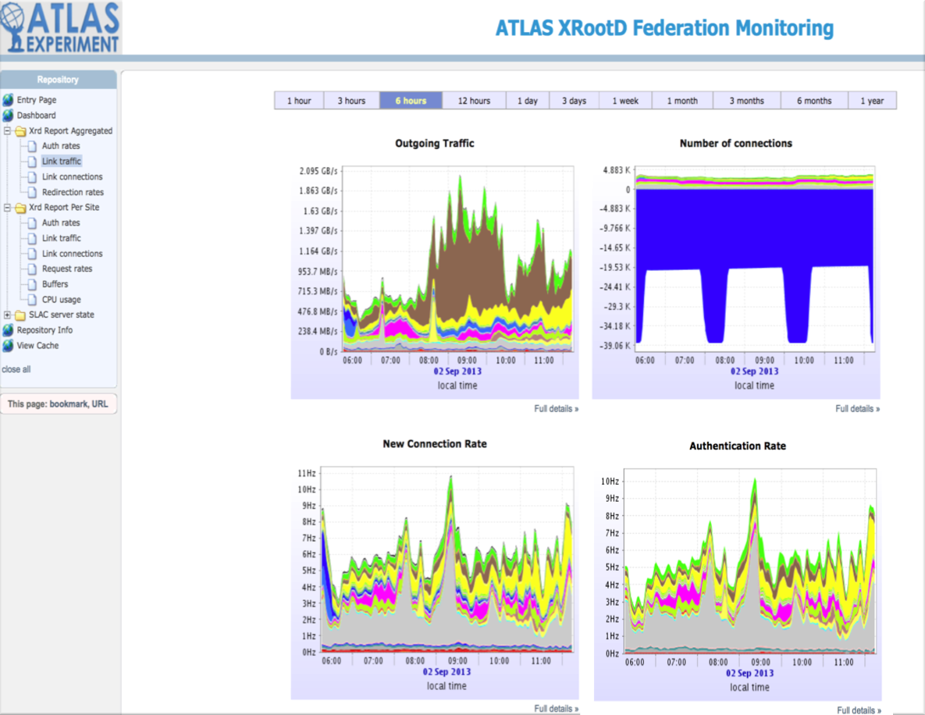
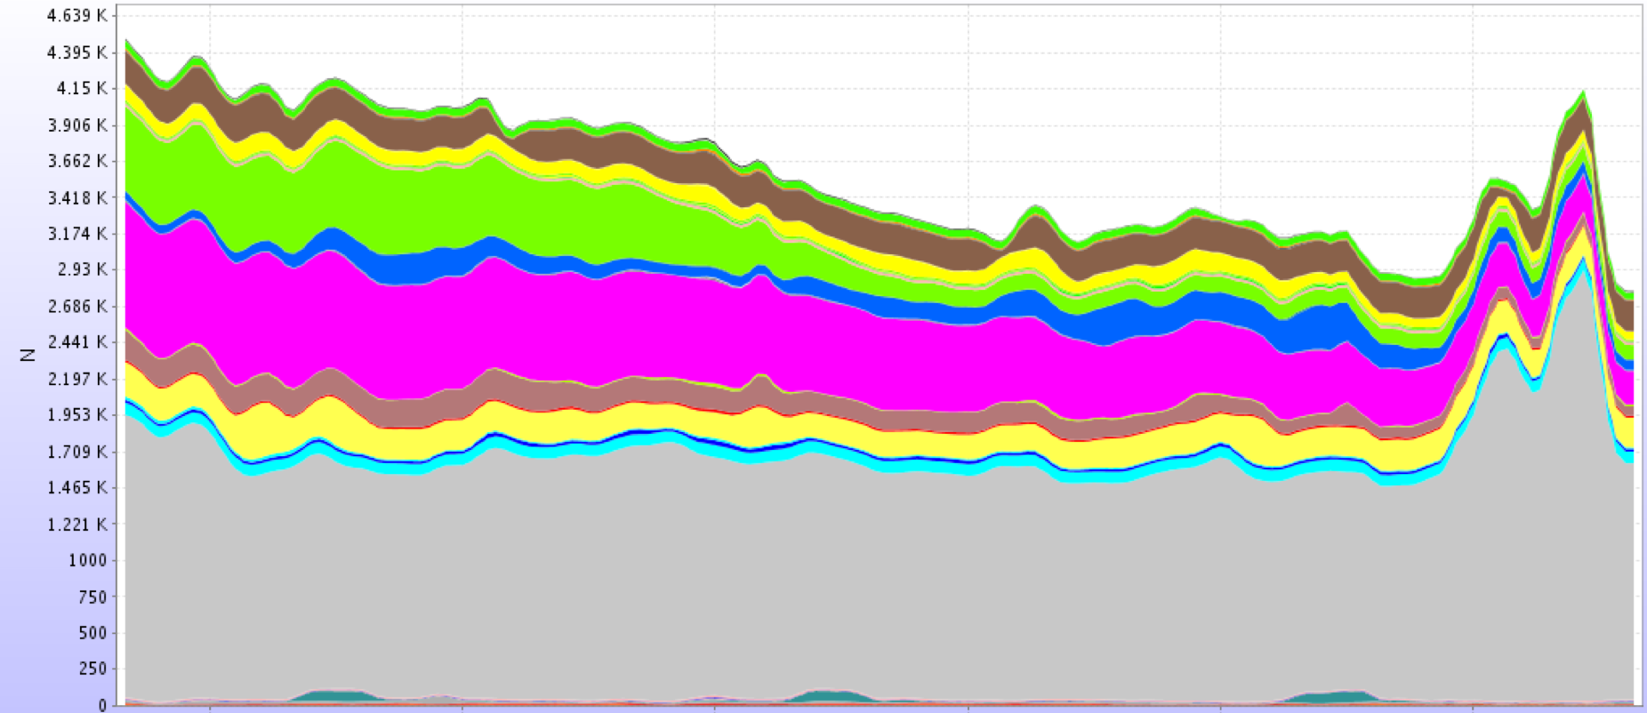
“Summary” Monitoring Stream
Lightweight
XML
throughputs
connections
redirections
per site
per server
Results stored in postgresql
Shown in MonaLisa

Slide 14
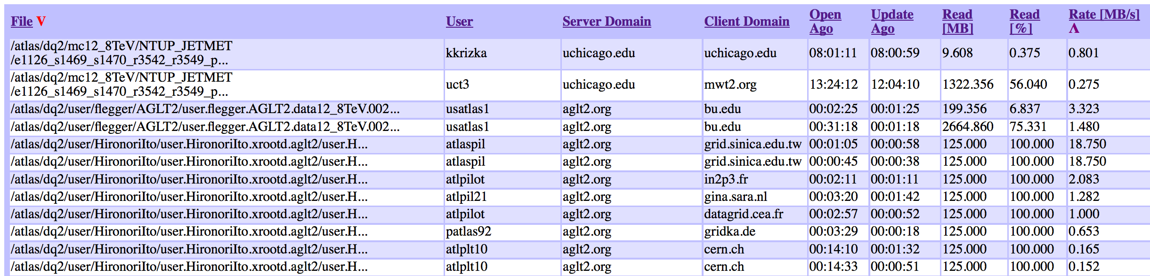
“Detailed” Monitoring Stream
Real time ➔ actionable!
File info
Path
Size
Open
Close
Reads/writes,…
User info
Hostname
DN
Process ID
Server info
Application Info
Can see each currently open file
Usually >5k files
http://atl-prod05.slac.stanford.edu:4242/

Slide 15
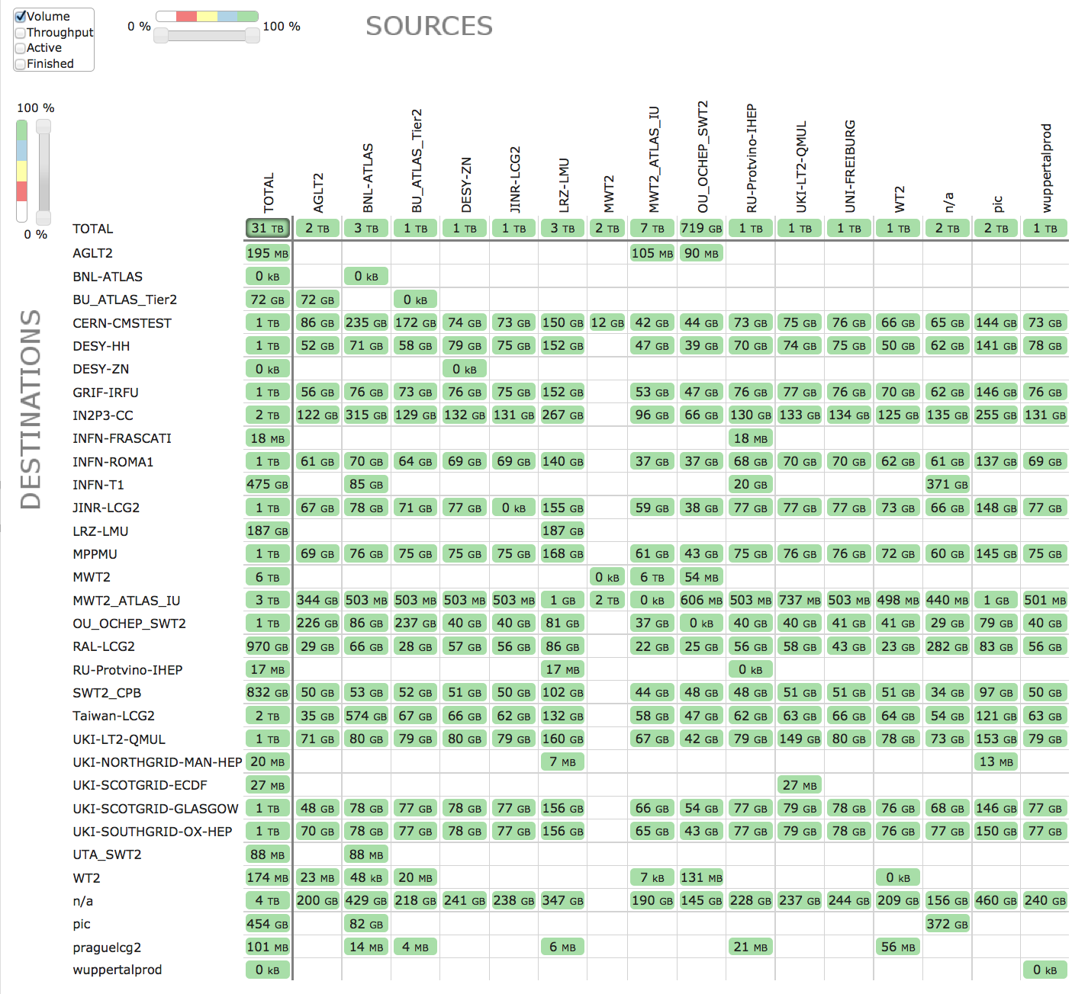
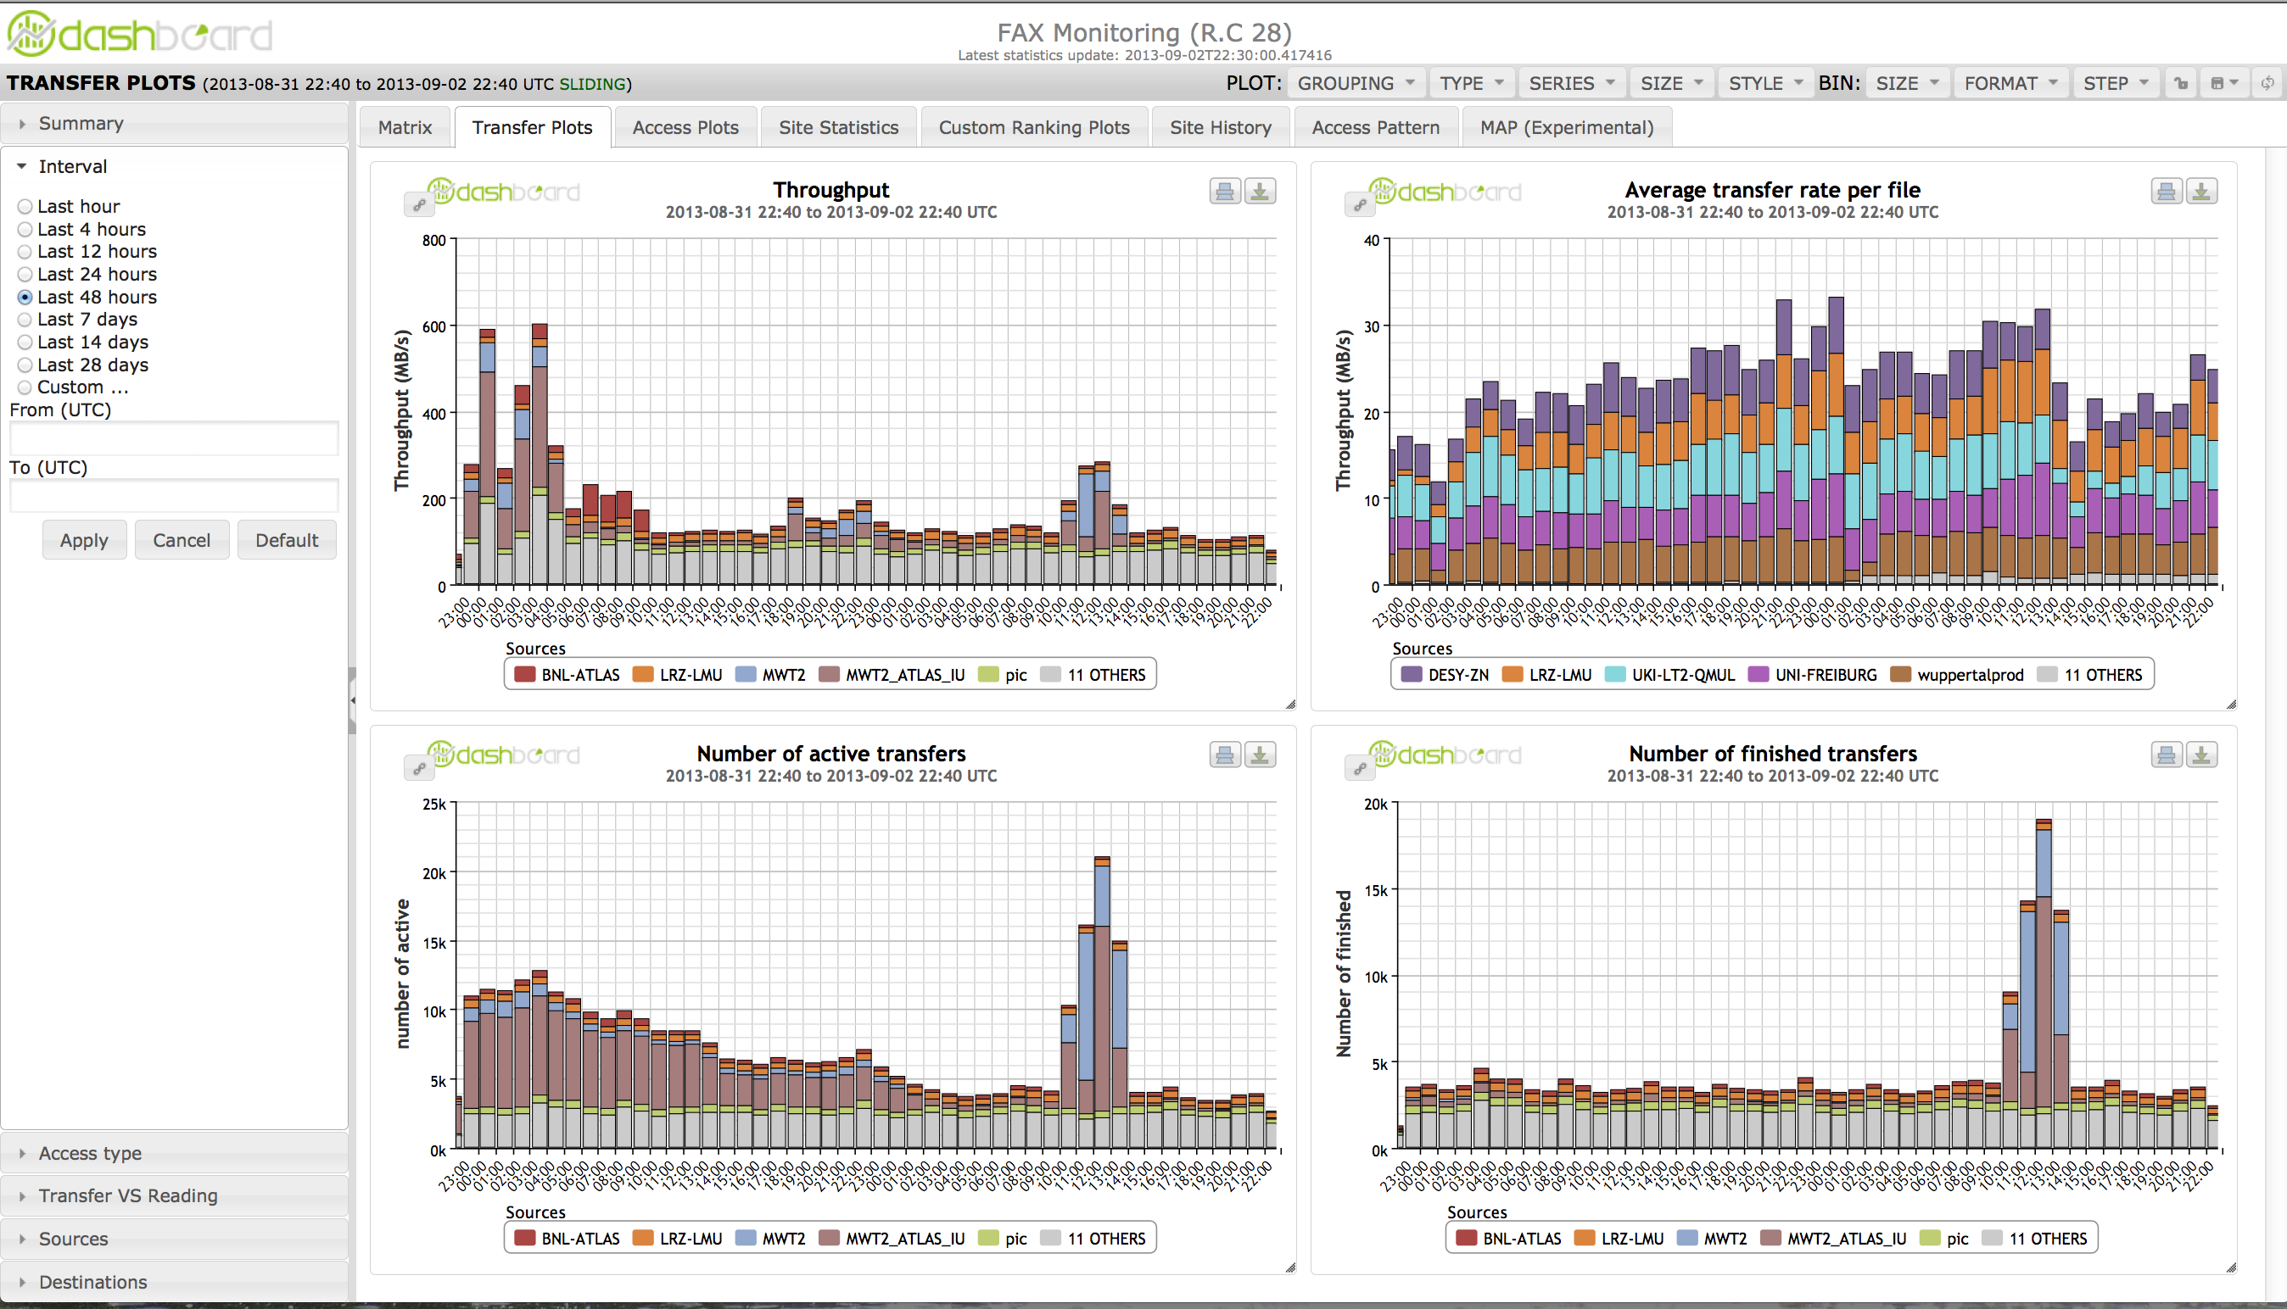
Detailed Monitoring: WLCG dashboard
Collects and keeps all the information
Will make it easy to slice & dice data
This is what shifters will look at when in production

Slide 16
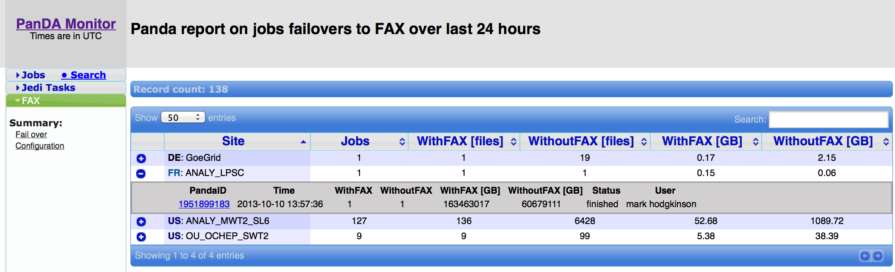
Job Failover using FAX
PanDA (distributed production and analysis system for ATLAS) sends a job only to a site having all the input data. In case that an input file can not be obtained after 2 tries, the file will be obtained through FAX in case it exists anywhere else.
There are in average 2.8 copies of files from recent reprocessing in FAX so there is a large change of success.
Ultimate success would be for a site to for example update its storage without first draining it of jobs.
Small number of jobs failing
But these failures cost the most in terms of user’s turn-around time

Slide 17
FAX usage in Job Brokering
One can broker jobs to sites that don’t have all or part of input data and use FAX to read them directly. Beneficial in cases where
A site has very often full queues as some specific data exist only there
A site has free CPUs, good connectivity but not enough storage/data
One can use external sources of CPU cycles (OSG, Amazon/Google cloud based queues,…)
For this approach to be efficient, system has to “know” expected available bandwidth between a queue and all of the FAX endpoints
We continuously measure this data and store it in Cost Matrix.
We expect brokering to FAX to be functional in a few months.

Slide 18





Measures transfer rates (memory-to-memory) between 42 ANALY queues and each FAX endpoint
Jobs submitted by HammerCloud
Jobs send results to ActiveMQ, consumed by dedicated machine stored in SSB with other network performance measurements - perfSONAR and FileTransferService
Cost matrix
FAX
PanDA job brokerage
FTS
SSB
Sonar
view
SSB
FAX cost matrix
REST
HammerCloud

Slide 19
FAX-based applications
With dedicated or on-demand CPU, one can provide “MapReduce-like” web service applications
Ongoing development
Event Picking Service
Plucks small chunks of data from large numbers of data sets
Skim and Slim Service
To help users go from multi-terabyte scale to multi-gigabyte scale
A common grid use case
A lot of optimizations possible if provided as a service
Need to find balance between making it general and useful enough while limiting resource usage

Slide 20
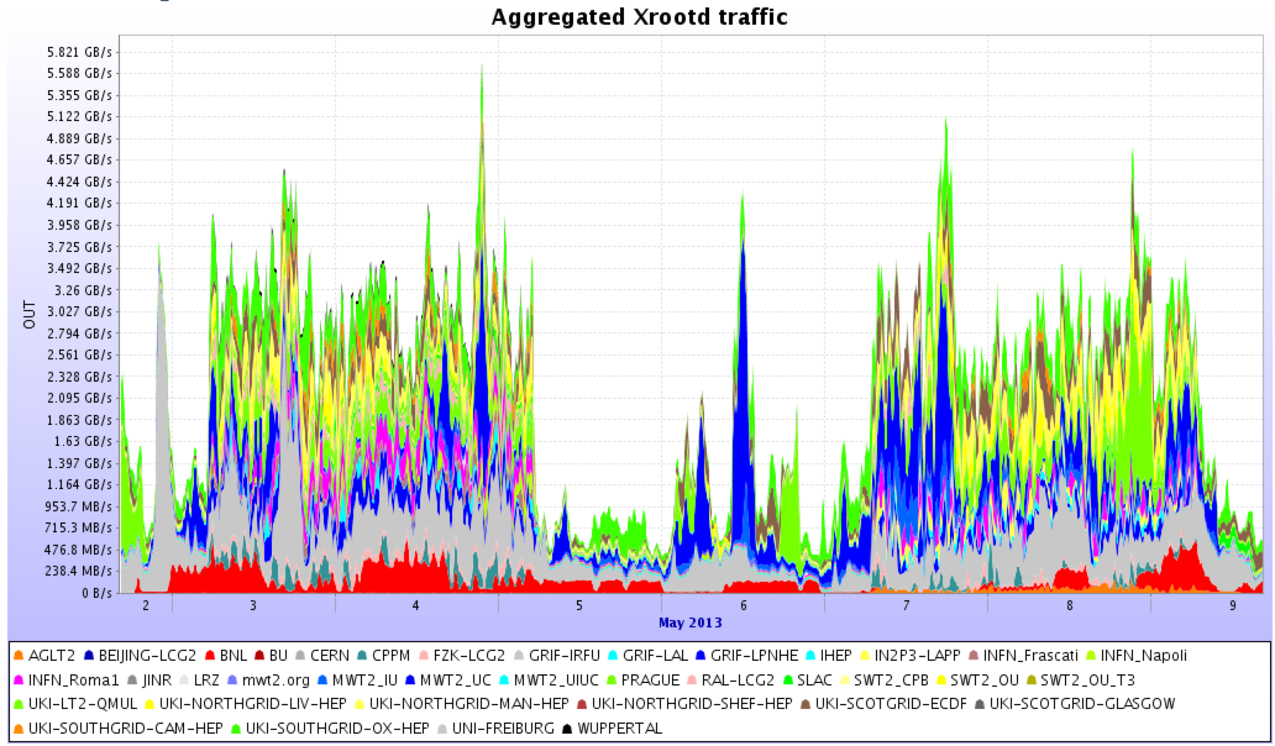
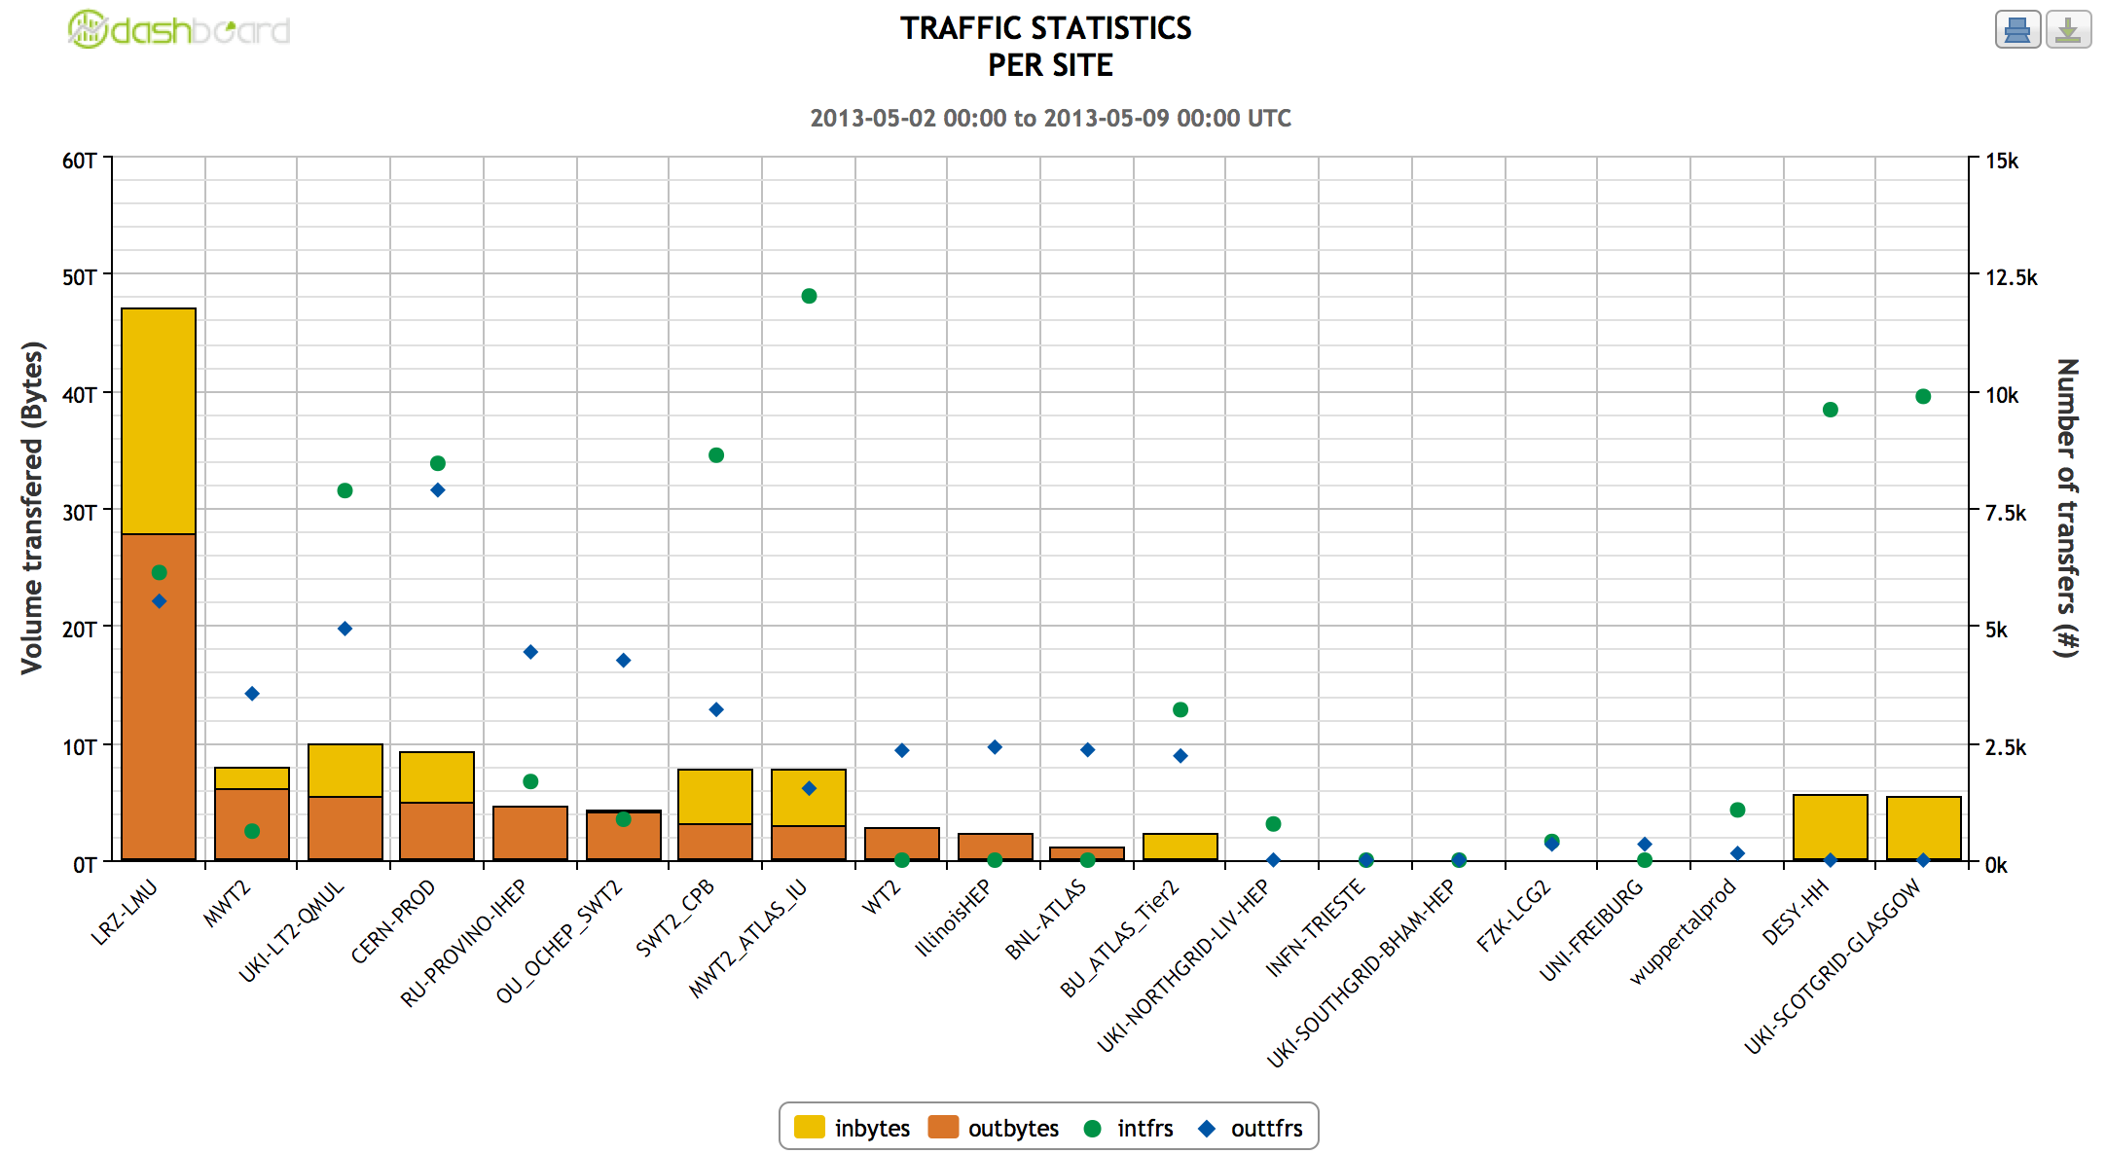
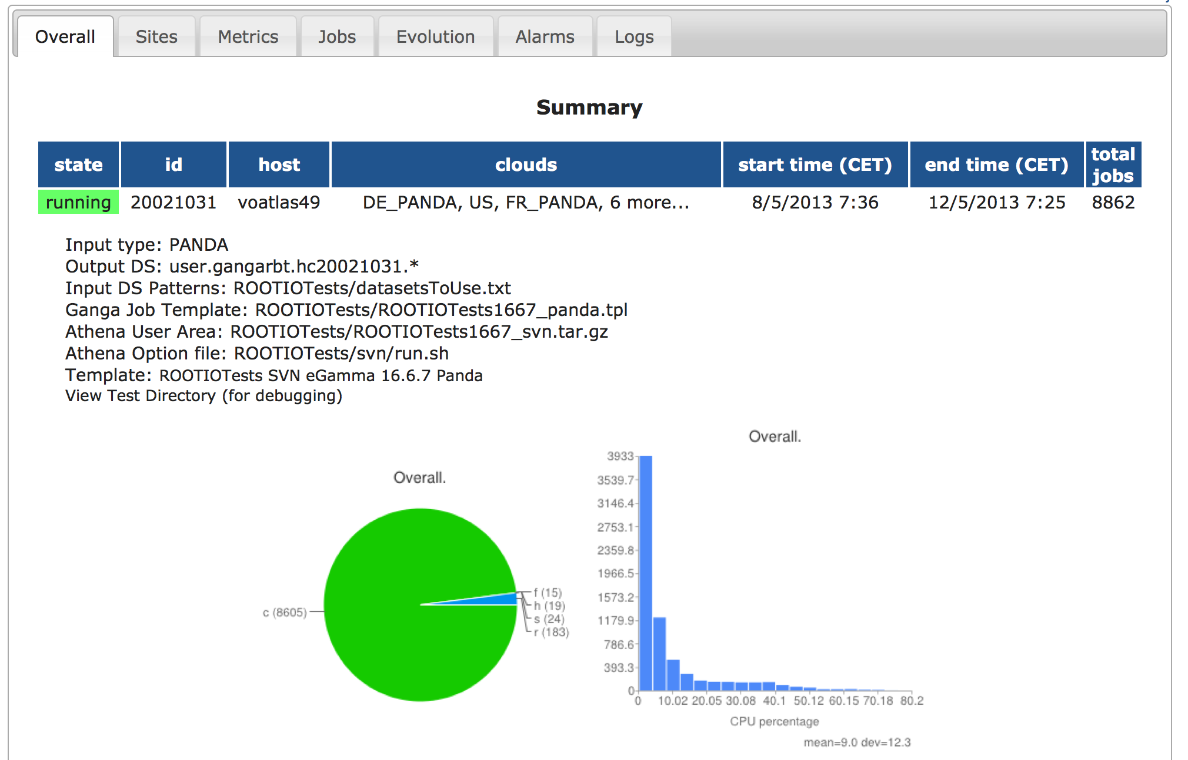
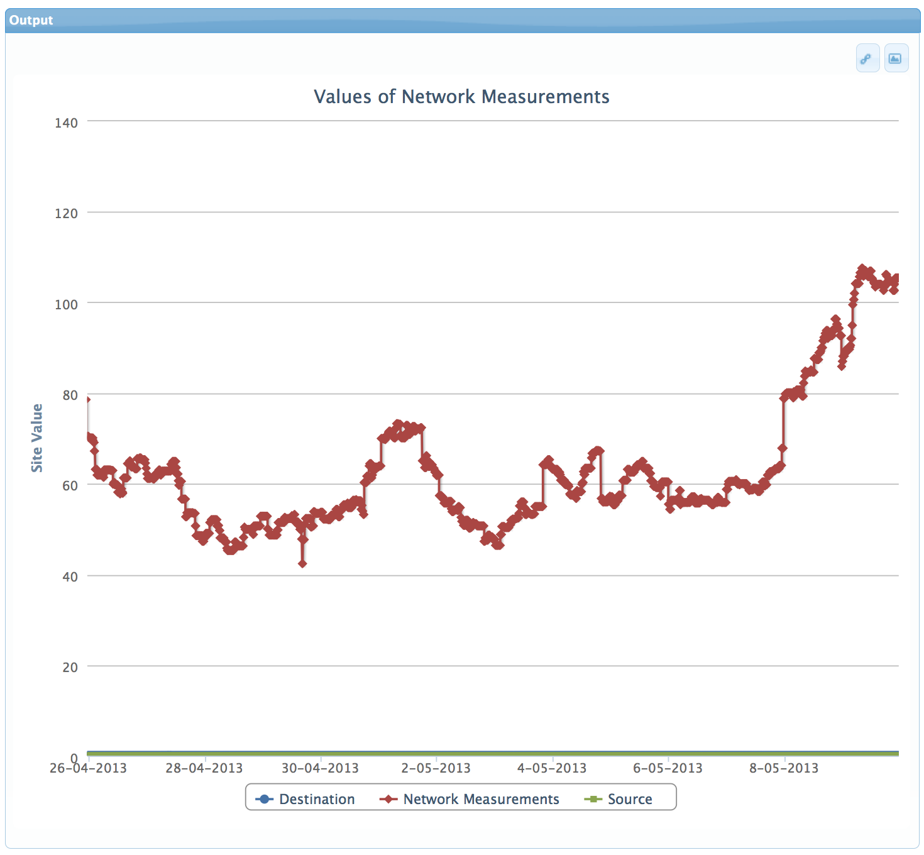
Performance
Metrics
Data Coverage >98%, >2.8 replicas
Number of users production, few tens of individual users
Percentage of successful jobs >99% from last tests
Total amount of data delivered ~2PB/week
Bandwidth usage
Source
Ganglia plots
MonaLisa
FAX Dashboard
HC tests
CostMatrix tests
Special tests using
dedicated resources
Notes:
There are many different performance metrics one can define for system with so many components. Here’s the list of the most important ones.
Very good coverage, and is getting better
We could do better job in getting users
Very small number of errors (these are all the errors in HC jobs not only FAX related ones)
While we’ve seen peaks of 6-7 GB/s, that’s mostly driven by our tests and UofC and Prague users. Still small compared to DDM transfers.
At our bi-weekly meetings we look at all of these but here will concentrate only on the last one of metrics : bandwidth available
There are different ways to get this information, all with it’s goods and bads.

Slide 21
Performance
HammerCloud based test
Running real analysis code
100 concurrent jobs from each site
Arrow width proportional to average
event rate
91
MWT2
45
166
64
49
SLAC
118
BNL
284
56
100
246
WAN performance can be as good as LAN
87
37
198
99
AGLT2
54
115

Slide 22
Future
Increase coverage, add redundancy, increase total bandwidth
Add the rest of sites
Increase performance, reduce bandwidth needs
Caching
Cost matrix – smart FAX
Smart network - Bandwidth requests, QOS assurance
Improve adoption rate
Presenting, teaching, preaching
New services
Improve satisfaction
FAX tuning
Application tuning
New services

Slide 23
Conclusions
Federation is functional
First use cases implemented
Usage is increasing
Powerful tool that has to be used wisely
Took more effort than initially expected
A lot of people (in different time zones) involved
Had to develop things multiple times for different storage technologies
Had to integrate it in our frameworks
Establishing effective monitoring as complex as establishing federation

Slide 24
Thank you! Questions?

